Slide 1
Preparing for Kindergarten Success: Kindergarten Orientation
2012
What to Expect in Kindergarten with Mrs. Hambey

Slide 2
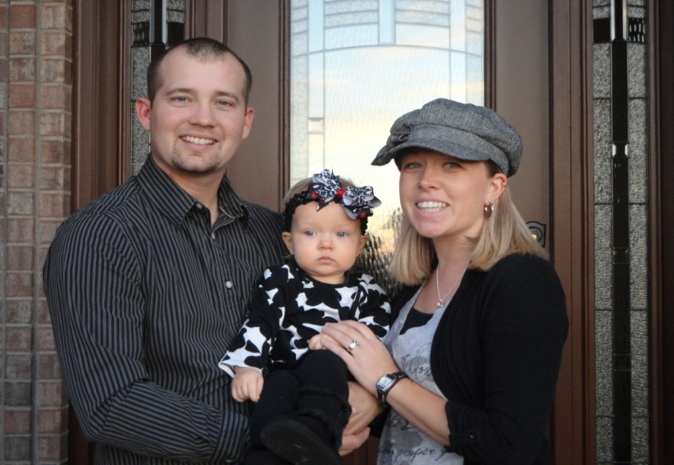
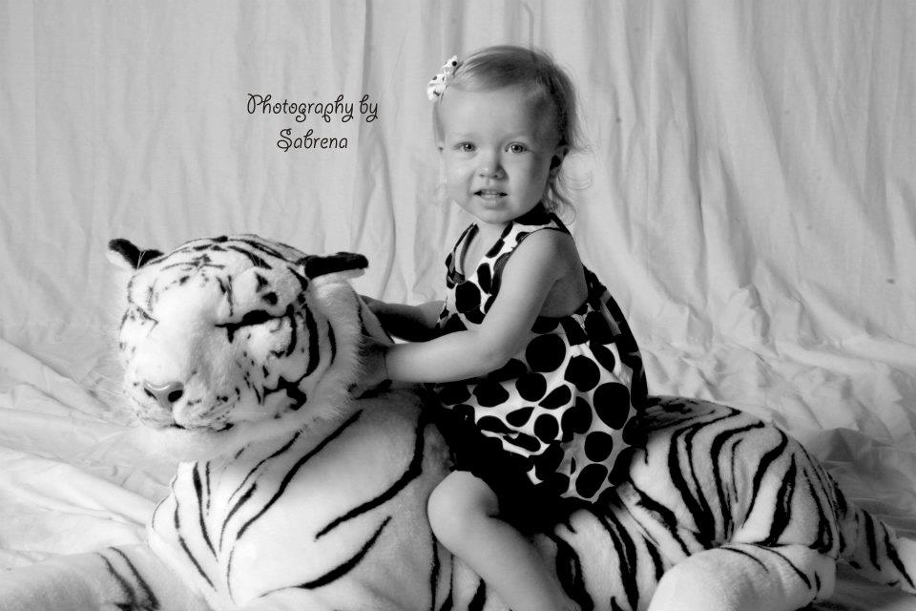
Meet Mrs. Hambey
I will be starting my 6th year teaching at Willard. I received a Bachelors of Science in Elementary Education in 2005 from Missouri State University. I also have a certification in Early Childhood Education. In May 2010 I received my Masters in Elementary Administration.
I graduated from Walnut Grove High School in 2002. My husband, Eric, and I met in high school and we were married on January 1, 2005. We have one daughter Alivia Jo, she was born on September 30, 2010. She is such a blessing and I love spending time with her! We also have a bloodhound dog, and his name is Brusier.

Slide 3
Math
When learning math, your child will participate in Calendar Time daily, which gives us a chance to work on basic math skills such as counting, identifying coins and shapes, etc.
We use a curriculum called “Investigations” for our math lessons, which offers your child a cooperative, hands-on learning experience.

Slide 4
Math
By the end of Kindergarten your child will be expected to complete the following tasks:
Rote count to 100 and write numbers to 20
Touch Count 20 or more objects
Identify numbers to 20
Count by 10’s to 100
Connect number words orally to a quantity up to 15
Add and Subtract with objects
Create, recognize, and extend patterns
Describe and identify 2 & 3 dimensional shapes
Identify & tell value of penny, nickel, dime, & quarter
Compare & order objects according to size & weight
Use non-standard units to measure length
Describe passage of time using today, yesterday, tomorrow
Sort objects according to size, color, & shape
Create and interpret simple graphs using objects
Know & understand position words (above, below, beside)

Slide 5
Reading
All Kindergarten classrooms will be using Daily 5, a part of Comprehensive Balanced Literacy. Comprehensive Balanced Literacy takes the best practices and combines them to provide your child with the best instruction, which is centered on meeting ALL students’ individual needs.
Your child will learn to read through Shared Reading, Poetry, Small Group Reading (Guided Reading), and Read Alouds. Our reading instruction is very individualized, as we understand that children are at different levels of development. We have high expectations for our students and push them to reach their highest potential, knowing that this may be different for every student.

Slide 6
Reading
By the end of Kindergarten your child should have mastered the following tasks:
Directionality (reads from left to right, then return sweep)
Know that print tells a story
1 to 1 word match when reading
Hear & say sounds in words
Produce Rhyming words
Identify all upper & lower case letters
Knows the sound each letter makes and transfer this skill when reading & writing.
Use comprehension skills when reading
Use strategies to figure out unknown words when reading
Read kindergarten high frequency/sight words (popcorn words)
Love to read!! :)

Slide 7
Writing/Spelling
To teach your child to write, we will be using Writers Workshop, which is also a part of Comprehensive Balanced Literacy. We use a variety of strategies, including word work, whole group mini-lessons, assisted writing, interactive writing, and 1 on 1 conferences.
Our writing instruction is very individualized. Through daily 1 on 1 conferences we are able to differentiate our instruction for every student in the class.

Slide 8
Writing/Spelling
Your child will be expected to do the following by the end of the year:
Form letters correctly (using path of movement)
Use spaces between letters/words
Hear and write the beginning, middle, and ending sounds in words
Use capital letters correctly
Use periods at the end of sentences
Plan and tell a story using pictures, words, and multiple sentences.
Revise and edit a story
Use sight words in story
Read his/her story to a teacher or peer
Segment sounds in words
Add a sound to the beginning of a word to make a new word (add /s/ to the beginning of the word at=sat)
Take a sound away from the beginning of a word to make a new word (take the /b/ away from bad=ad)
Be able to produce the word when given the sounds in that word
(/c/ / a/ /t/, makes the word cat)
Be able to tell the sounds they hear in a word (sat, /s/ /a/ /t/-student makes each individual sound)
Understand how words work & be flexible when using words
(word families, chunks, blends...etc.)
Write for a variety of purposes
Love to write :)

Slide 9
Science/Social Studies
Your child will also be exploring Science and Social Studies objectives as we engage in experiments and lots of hands-on learning.
By the end of Kindergarten your child should be able to participate appropriately in classroom discussions and activities.
Our curriculum consists of Scott Foresmen Science and Weekly Readers.

